Slide 1
Wolves in Adirondacks
Charles Anderson, Jack Caulfield, Ryan Frohlich, Garrett Sykes, Klementyna Cemerys
Our project focuses on the viability of reintroducing wolves into the Adirondacks. Wolves have historically been extirpated from large parts of the United States and, recently, a dialogue has been sparked on whether it is viable to reintroduce them in the Adirondacks. We delve into the complex factors at play including the political, social, economic, ecological, and the stakeholders involved in this issue. Ultimately, this is a nuanced problem with multiple sides. Below we have gathered data and interviewed professionals on the issue to provide an articulate summation of whether proceeding with a reintroduction in the Adirondacks would be successful.

Slide 2
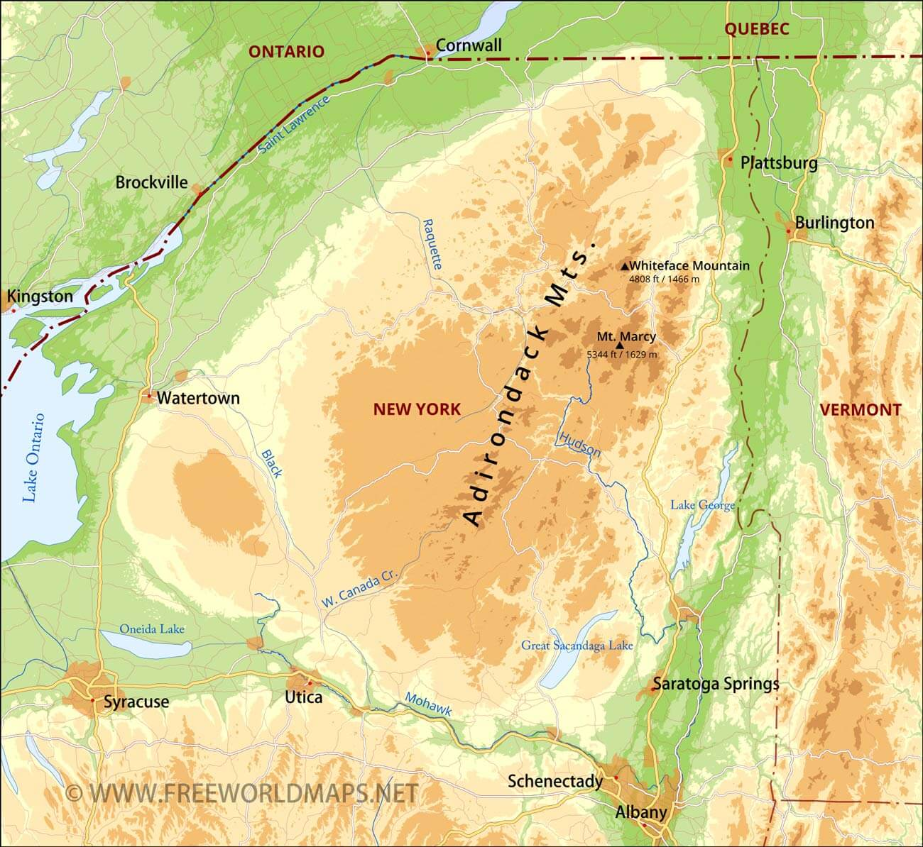
Background
The Adirondack Park is a six million acre protected region in Northern New York
Wolves were extirpated from the Adirondacks in the late 1800’s due to deforestation and hunting
As early as the original 13 colonies wolves have had bounties placed on them due to their danger to livestock
https://www.freeworldmaps.net/united-states/adirondacks/adirondacks-map.jpg
(Paquet et al. 1999.)
Notes:
BACKGROUND- Garrett

Slide 3
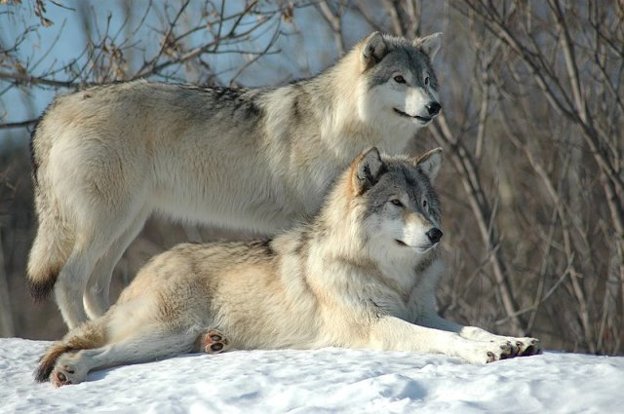
The stigma around wolves
This explanation suggests that fear and loathing of wolves is indicative of alienation from and animosity toward wildness (unconquered, untamed nature) in general, as expressed by a compulsive need to try to control it and overcome it.
When wolves preyed on cattle or sheep or pigs, they threatened more than the animals; they threatened the farmers’ chances of surviving the winter, their ability to provide for their families. The fight was personal.
The wolf stands for what we refuse to acknowledge as part of us. The dog symbolizes control, reminds us of our power, and is testimony to our ability to tame the wild. The wolf is our guilty conscience, for it reminds us of our humble origins, represents the freedom we gave up, the togetherness we abandoned.
https://howlingforjustice.wordpress.com/2012/12/02/22630/beautiful-wolves/
(Abrantes 2015)
(Robinson 2019)
(Hurt 2021)
Notes:
Robinson, K. 2019, June 28. The Psychology of Wolf Fear and Loathing. https://rewilding.org/the-psychology-of-wolf-fear-and-loathing/.
Why Do So Many Humans Hate Wolves? (n.d.). . https://www.discovermagazine.com/planet-earth/why-do-so-many-humans-hate-wolves.
Abrantes, R. 2015, January 30. The Wolf Within—The Truth About Why We Fear the Wolf.

Slide 4
Could New York sustain Gray Wolves today?
What has changed since the last wolf killed in the 1890s?
Increased human disturbance
Degraded habitats and connective matrixes
Replacement of Eastern coyotes and wolf-coyote hybrids; coydogs
Basic Requirement of Wolves:
>5.8 deer/km²
1500-3000 km² undisturbed habitat
Safe matrixes between high quality patches
Suitable denning
Protection from laws and livestock disease preferable
Adirondack Status:
< 2 deer/km²
16,020km² as of 1992 (Previously 24,280km²)
Division by railroads, highways, snow trails
Mix of suitable dens but with mild human disturbance
Removal from endangerment list in 2018
Wolves still use the Adirondacks! But its best as a corridor between southern Canada and potential locations like Maine or the Appalachian Mtns. Successful reintroduction relies on sustainability - Wolves are not expected to last more than 50 years if that long at all…
(Paquet et al. 1999.)
(Mladenoff and Sickley 1998)
Notes:
Klem
Recreational activities like snowmobiling, and an influx of railroads and highways wolves are commonly killed along

Slide 5
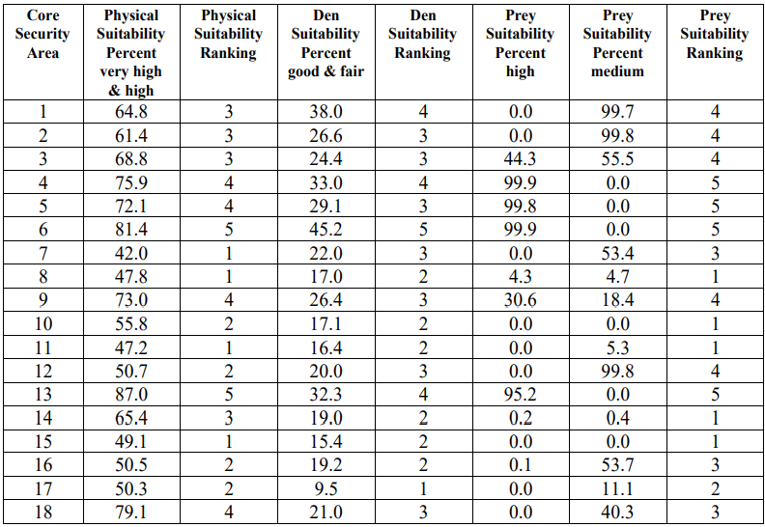
Table 13. Core security area ranking based on summer physical suitability, den suitability, and prey suitability for the Adirondack Park, NY
(Paquet et al. 1999.)
Notes:
Klem
An experiment on Adirondack feasibility of wolves in 1999 provided extensive insight into the major requirements by wolves.
This table looked at 18 core potential habitats
And ranked landscape suitability, den suitability, and prey suitabilities.
A 1 is a poor/unsuitable habitat and a 5 is good. The scores combine for a total score. The average was an 8.7, ranking as fair on their system.
Percents are portions of the sampled areas, so how many ranked high/suitable
Wolves need to move between habitats to survive, but the matrix between patches may not be viable.
Data based on summer since that’s pup season. Some data like precipitation still impacts suitability, decreasing likeliness anyways

Slide 6
Effect Gray Wolves would have on the ecosystem
Gray wolves are considered apex predators and keystone species
Wolves are excellent at controlling prey populations, which enables other plants and animals to flourish
Adirondacks: Some examples of mammals found in this region are white tail deer, coyotes, moose, bobcat, meadow voles, and snowshoe hare
Being apex predators wolves would prey on large and small mammals. Helping to control white tail deer populations and other small mammals like meadow voles.
On the other hand they would also help to control coyote populations. In the absence of apex predators in the eastern US coyote population have exploded. Gray wolves would help to drive coyote populations by competition and direct conflict(fighting)
Important ecological effects:
Increase biodiversity of both plants and animals
Control populations of species like deer and coyote
Make environment of the adirondacks healthier
Smith, D. W. 2002.
Lomolino, M. 2022.
Notes:
Jack Caulfield

Slide 7
Example: Trophic Cascade and Lyme Disease
Current Adirondacks Trophic System:
Coyotes/wolf hybrids (coydogs)
Prey: Foxes, opossums, and raccoons
Reservoir for lyme disease ticks/nymphs are in small mammals, which are prey to animals like foxes
Raccoons and opossums can remove nymphs through grooming
Abundance in reservoirs
Hypothesized Wolf reintroduction:
Wolves compete and kill coyotes
Decrease in predatory rates on foxes and other smaller Adirondack animals
Predation is then increased on the small mammals hosting disease borne ticks
Reduction in reservoirs
Reduction in life cycle success
Wolf reintroduction will restore one piece of the natural Adirondack heritage. A net positive will be in biota interactions with wolf reintroduction…
Dr. Lomolino’s interview
(Ostfeld et al. 2018)
(Levi and Wilmers 2012)
Notes:
Klem: Wolf reintroduction and trophic system
Adirondack’s top predator currently are large, aggressive coyotes and wolf-coyote hybrids called coydogs that pretty on smaller mammals and marsupials like foxes, opossums, and racoons.
The diet of foxes, small mammals, and the grooming habits of raccoons and opossums, displace a large portion of nymphs responsible for transmitting lyme disease.
With coyotes, These core predators are reduced in numbers, increasing the reservoir for nymphs carrying lyme disease
What wolf introduction can provide is change in this cascade to prey on coyotes, relieving the populations of foxes, raccoons, and opossums. Wolves are used to hunting larger animals like ungulates, and coyotes possessing the same diet only amplifies the need to hunt them.
Ostfeld, R. S., T. Levi, F. Keesing, K. Oggenfuss, and C. D. Canham. 2018. Tick-borne disease risk in a forest food web. Ecology 99:1562–1573.

Slide 8
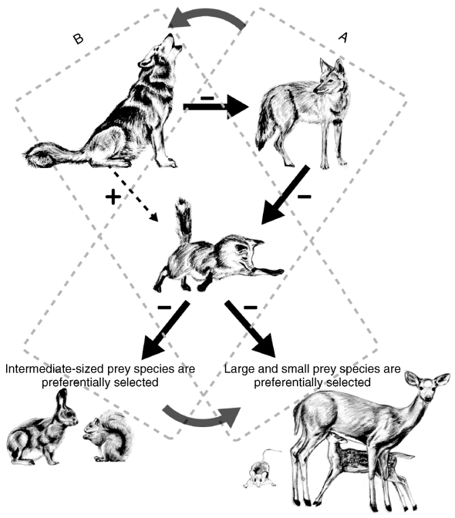
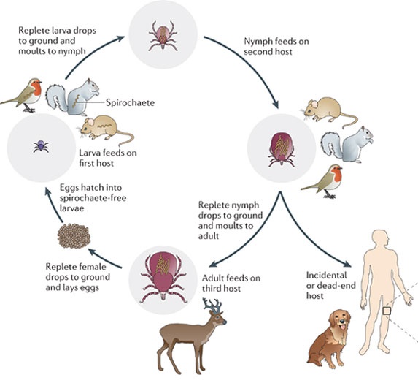
(Levi and Wilmers 2012)
Notes:
Klem
Levi, T., and C. C. Wilmers. 2012. Wolves–coyotes–foxes: a cascade among carnivores. Ecology 93:921–929.

Slide 9
Economic Implications For Wolf Reintroduction
Reintroducing animals into an environment where they previously inhabited is very costly. All the labor, research, and monitoring adds up to an extensive price tag for reintroductions. In Yellowstone, wolf reintroduction cost between $200,000 and $1 million per wolf that was introduced and required continual monitoring. That’s a heavy price New York taxpayers would have to accept if they wanted wolves included in the Adirondack landscape.
U.S. Fish and Game estimated that wolves reintroduced in Yellowstone would kill 50 cattle and 200 sheep per year; however, between 1995 and 1999 wolves only killed 80 sheep, 11 cows, and one hunting dog. Substantially less damaging than they previously expected for ranchers in the region to cope with. They’ve found that wolves prefer not to eat livestock and only hunt domestic animals if there is a shortage of food making them do so.
They found in Yellowstone that wolves hunted and controlled pest species that harass ranchers incessantly like coyotes and reduced their numbers down to healthier levels, provided a notable benefit for the ranchers.
Wolves created an incentive for tourists to go to Yellowstone, with >36,000 visitors coming the same year they were introduced in 1995 in hopes of seeing them. This could increase ecotourism in the Adirondacks in positively influence local communities there that rely on seasonal tourism for their income.
(Geissinger, 1999)
Notes:
Charles

Slide 10
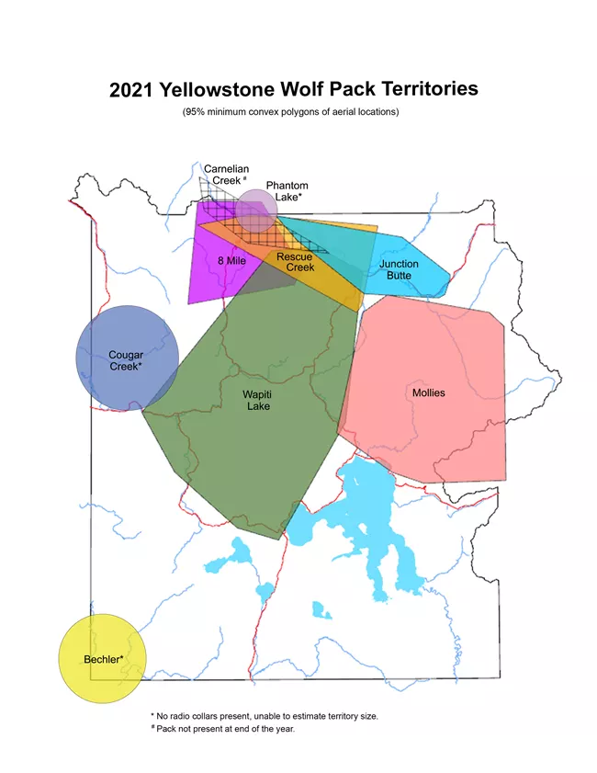
The Yellowstone Reintroduction
1973- Endangered Species Act passed, requires the Fish & Wildlife Service to preserve endangered species
1991- congress provided funds to Fish & Wildlife for the restoration of wolves
In 1994, 1995, and 1996 wolves were captured in Canada by Fish & Wildlife and relocated to Yellowstone and Central Idaho
Local opposition pushed the reintroduction back by two decades
As of December, 2020, there are over 95 wolves in the park
(Fritts et al. 1997)
(Park and Us n.d.)
https://www.nps.gov/yell/learn/nature/wolves.htm#:~:text=As%20of%20December%202021%2C%20there,Eight%20packs%20were%20noted.
Notes:
Garrett

Slide 11
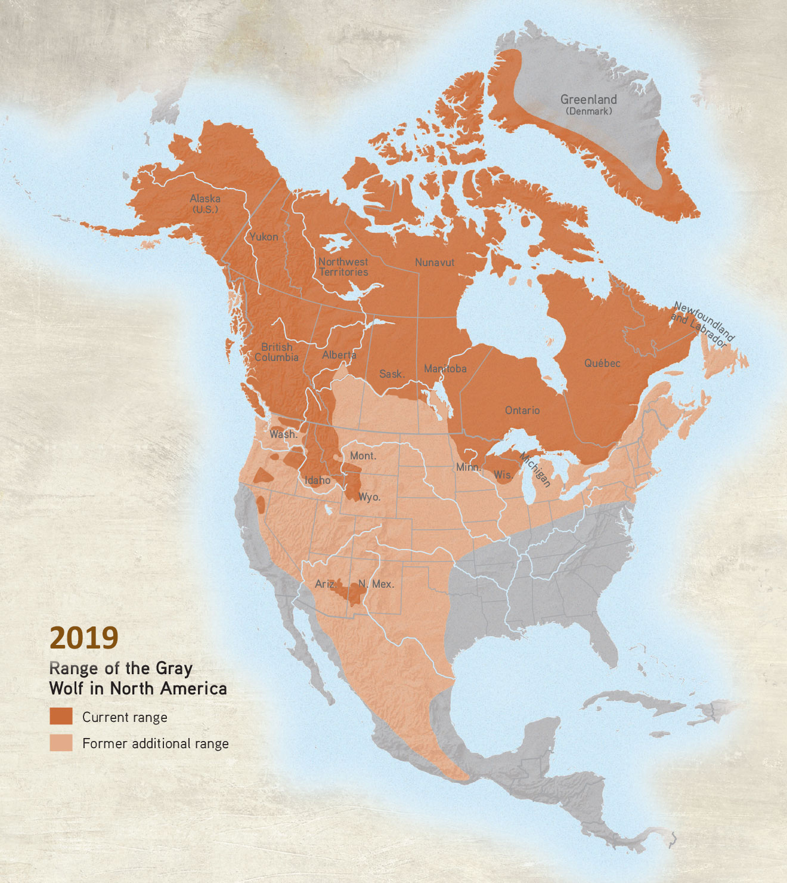
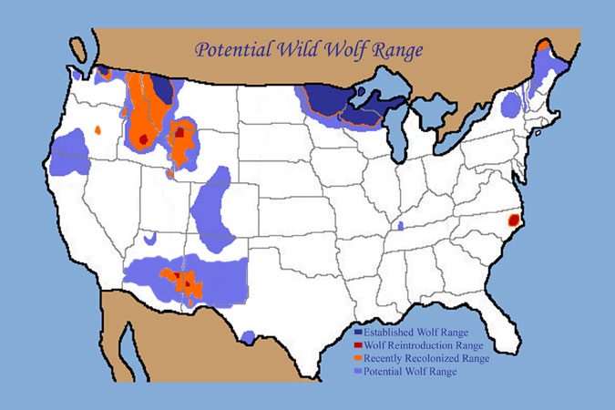
Can wolves re-introduce themselves?
https://www.livingwithwolves.org/meet-the-wolf/
https://www.graywolfconservation.com/Wild_Wolves/history.htm
Notes:
Jack Caulfield

Slide 12
Conclusion:
Feasibility:
Based on our research it seems at the moment it is not feasible to reintroduce wolves into the adirondacks, but they may be found here one day in the future !
Based on political,societal, economical, environmental reasons its seems unlikely that wolf would be able to survive in the Adirondack region at this present time
For the future:
More public awareness on the importance of wolves could help to raise funds and change the negative stigma associated with wolves
Areas set aside in the Adirondacks that would both have enough usable habitat and resources to support wolves would be necessary
A soft reintroduction would have to be the plan set in place to ensure when they are reintroduced successfully
We may not need to reintroduce wolves as they will most likely repopulate certain areas of NY on their own from traveling from areas of Canada and WI
Notes:
Jack Caulfield

Slide 13
Works Cited
Dr, Lomolino.Mark. 2022, November 28th. Research based interview. Suny ESF
Fritts, S. H., E. E. Bangs, J. A. Fontaine, M. R. Johnson, M. K. Phillips, E. D. Koch, and J. R. Gunson. 1997. Planning and Implementing a Reintroduction of Wolves to Yellowstone National Park and Central Idaho. Restoration Ecology 5:7–27.
Geissinger, R. 1999, November 12. Wolf Reintroduction in Yellowstone National Park. Goshen College..
Levi, T., and C. C. Wilmers. 2012. Wolves–coyotes–foxes: a cascade among carnivores. Ecology 93:921–929.
Mladenoff, D. J., and T. A. Sickley. 1998. Assessing potential gray wolf restoration in the northeastern United States: a spatial prediction of favorable habitat and potential population levels. The Journal of Wildlife Management 62:1–10.
Ostfeld, R. S., T. Levi, F. Keesing, K. Oggenfuss, and C. D. Canham. 2018. Tick-borne disease risk in a forest food web. Ecology 99:1562–1573.
Park, M. A. P. B. 168 Y. N., and W. 82190-0168 P. 307-344-7381 C. Us. (n.d.). Gray Wolf - Yellowstone National Park (U.S. National Park Service). https://www.nps.gov/yell/learn/nature/wolves.htm.
Paquet, P. C., J. R. Strittholt, and N. L. Staus. 1999. Wolf reintroduction feasibility in the Adirondack park:69.
Roell, and J. L. Belant. 2022. Identifying potential gray wolf habitat and connectivity in the eastern USA. Biological Conservation 273:109708.
Smith, D. W. 2002. Review of wolves and human communities: biology, politics, and ethics. Journal of Mammalogy 83:915–918.
Welcome to the Adirondacks - NYS Dept. of Environmental Conservation. (n.d.). . https://www.dec.ny.gov/outdoor/119734.html.
Van den Bosch, M., D. E. Beyer, J. D. Erb, M. G. Gantchoff, K. F. Kellner, D. M. MacFarland, D. C. Norton, B. R. Patterson, J. L. Price Tack, B. J.

Slide 14
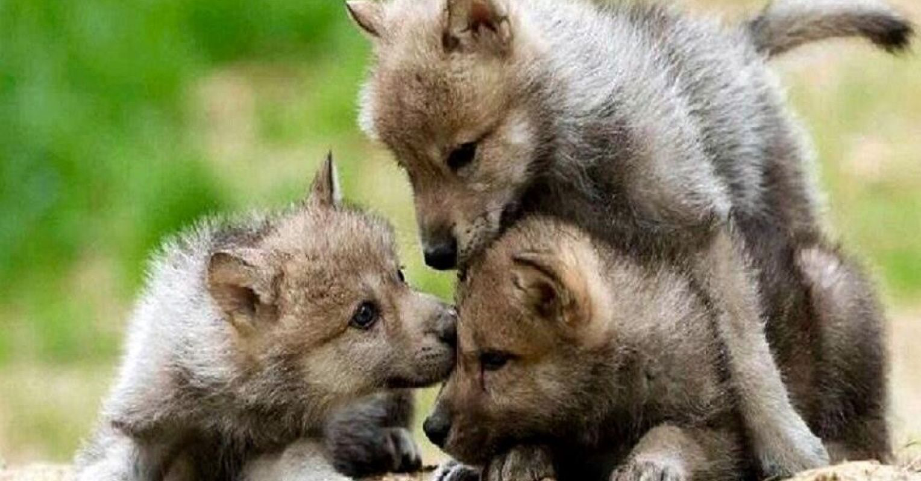
Questions

